Slide 1

FACULTY OF INFORMATION TECHNOLOGY
Educational website for learning sign language

Slide 2
Presented by
Sara Sayed Hussien 89635
Alaa Ahmed Mohamed 89670
Barakat Ramadan 89634
Abdelrahman Sharawy 89587
Supervised by
Dr. Maged Khafagy
TA. Ahmed Abdallah
TA. Mai Asse

Slide 3
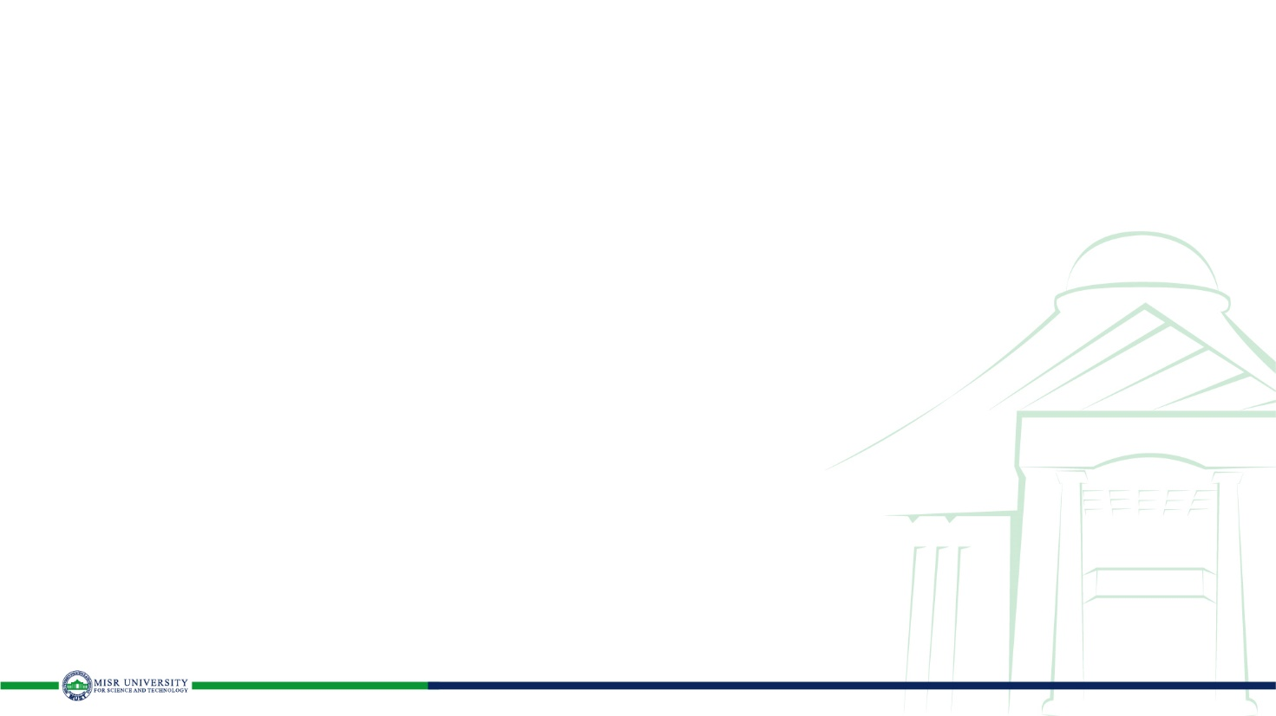
Agenda
Introduction
Possible Beneficiaries
Motivation
Main Objectives
SDG’s Goal
Related Works
Problem Definition
Proposed System
System Architecture
Methodologies and Techniques
System Requirements (S/W and H/W Tools)
Results and Outcomes
System Validation
Conclusion
References

Slide 4
Introduction
The creation of sign language helped close the communication gap between those who can hear and those who cannot for persons who have lost their hearing or are hearing impaired. The use of sign language, which consists of a variety of hand movements and symbols, allows the deaf and hard of hearing to engage with their environment.
Anyone interested in being able to communicate with people who are hearing impaired should learn and comprehend sign language. Sign language is not just for people who are deaf. Learning sign language is not difficult, and studies show that there is an increasing need for sign language users in the workplace and globally. To meet this need, some schools and institutions have created degree programs in sign language.

Slide 5
Possible Beneficiaries
You may communicate with a variety of hearing, hard-of-hearing, and deaf people by learning sign language, including students in mainstream and deaf school or university programs, deaf or hard-of-hearing locals, and businesspeople.
We may classify research goals into the many main categories listed below:
1. Students will have the foundational vocabulary and grammar for communicating
at the beginner level.
2. Anyone will be able to access the site and learn sign language.
3. It will make it easier for students to learn sign language from their homes without
having to go to specialized centers to teach sign language.
4. The site will make a quiz for the student after the end of each course he studies.
5. Students will be able to distinguish slowly written and signed numerals as well as
rudimentary fingerspelling of the numbers.

Slide 6
Motivation
There are many people and some families who have children, friends or some relationships who suffer from hearing disabilities and face some difficulties in communicating with each other, due to the inability of some to go to centers designated to learn sign language, due to the distance of these centers or their unavailability in neighboring areas To them or to the high cost of learning sign language in some centers. People who are Deaf or hard of hearing frequently use sign language as their primary means of communication, yet sign languages have a lot to offer to everyone. Look at these things:
Possibility to interact with the Deaf community.
It is the language that Deaf and hard of hearing individuals can use the most easily.

Slide 7
Main Objectives
You may communicate with a variety of hearing, hard-of-hearing, and deaf people by learning sign language, including students in mainstream and deaf school or university programs, deaf or hard-of-hearing locals, and businesspeople.
We may classify research goals into the many main categories listed below:
1. Students will have the foundational vocabulary and grammar for communicating
at the beginner level.
2. Anyone will be able to access the site and learn sign language.
3. It will make it easier for students to learn sign language from their homes without
having to go to specialized centers to teach sign language.
4. The site will make a quiz for the student after the end of each course he studies.
5. Students will be able to distinguish slowly written and signed numerals as well as
rudimentary fingerspelling of the numbers.

Slide 8
SDG’s Goal
The SDG's do not have a specific goal dedicated to educational websites for learning sign language, but the following goals can be relevant to such a website:
1. Goal 4: Quality Education - Ensure inclusive and equitable quality education and promote lifelong learning opportunities for all. This goal emphasizes the importance of providing quality education to everyone, including those with disabilities, and promoting lifelong learning opportunities.
2. Goal 10: Reduced Inequalities - Reduce inequality within and among countries, including inequalities experienced by people with disabilities. This goal emphasizes the need to address inequalities and discrimination faced by marginalized and vulnerable populations, including those with disabilities.
3. Goal 17: Partnerships for the Goals - Strengthen the means of implementation and revitalize the global partnership for sustainable development. This goal emphasizes the importance of partnerships and collaboration between governments, civil society, and the private sector to achieve the SDGs.
An educational website for learning sign language can contribute to achieving these goals by providing inclusive and equitable education opportunities for people with disabilities, reducing inequalities, and promoting partnerships and collaboration for sustainable development.

Slide 9
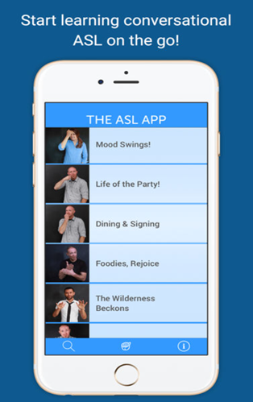
Related Works
ASL App:
You may learn American sign language easily and
step-by-step with the help of the ASL App. With more
than 2,500 signs and sentences, simple navigation
and features, and a variety of signers, The ASL App is
made to make learning simple, approachable,
and enjoyable.

Slide 10
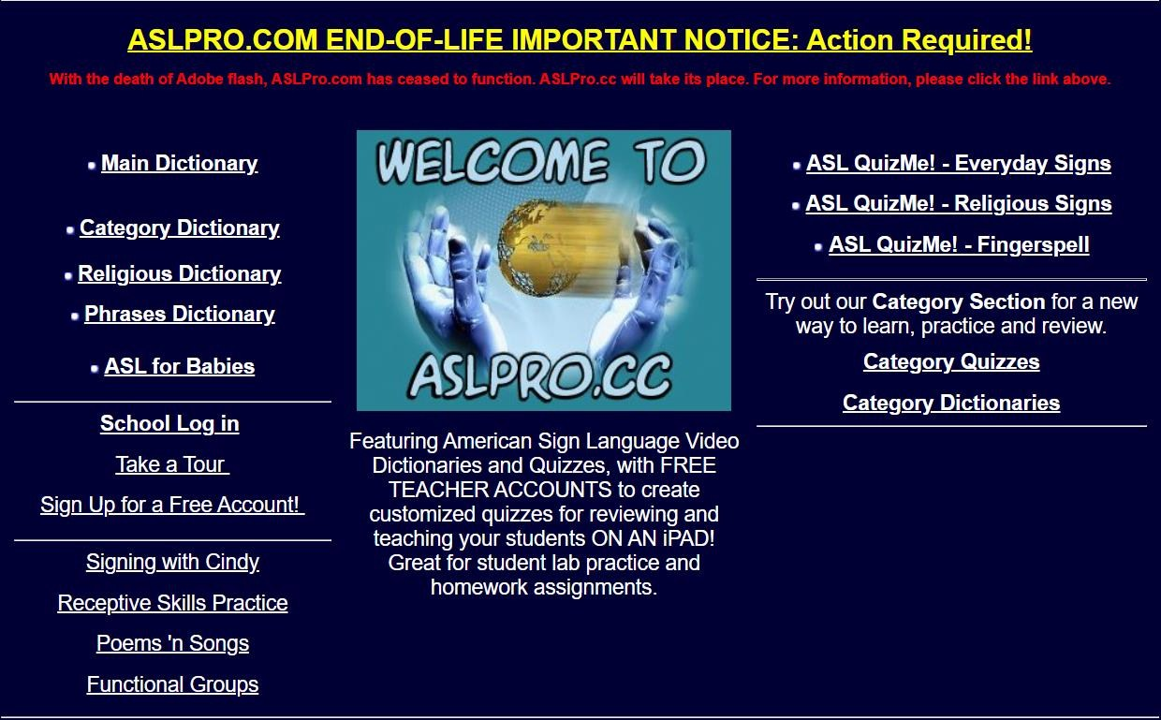
Related Works
Aslpro Web:
Great site to learn ASL on their website,
you can find great
educational tools you can learn everything
from the alphabet, to everyday words and phrases and more, the site is
completely free to use.

Slide 11
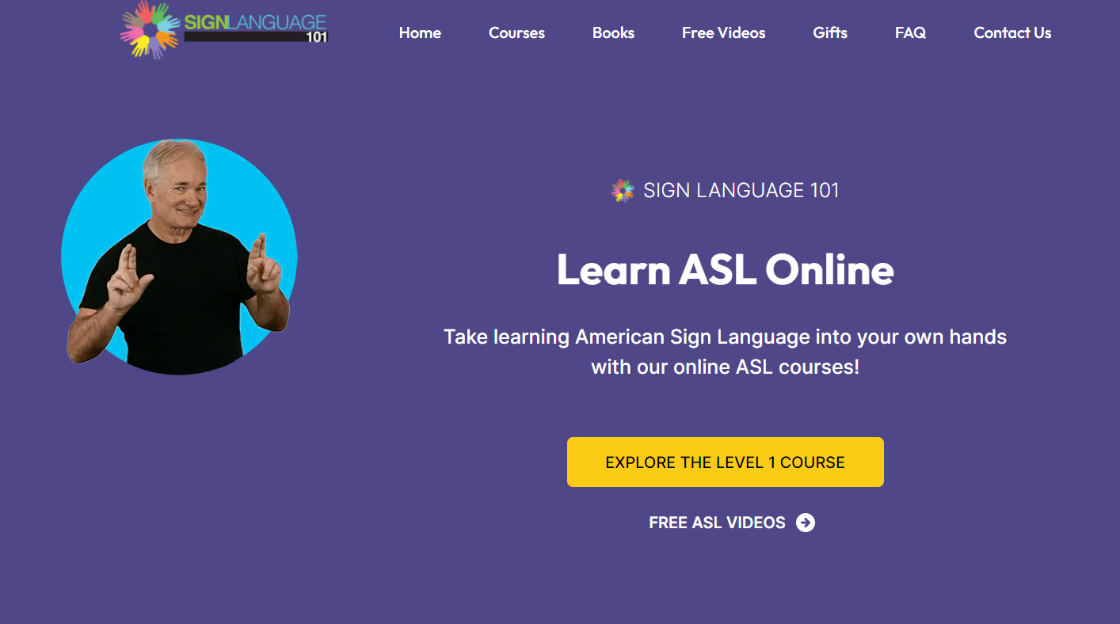
Related Works
Sign Language 101:
SIGN LANGUAGE 101 is one of the most popular sites for teaching sign language in American English, offering us courses and books to facilitate learning for learners. Dr Byron Bridges offers us American Sign Language (ASL) courses for adults at two full levels Level I and Level II. In addition to a sign language course for children.

Slide 12
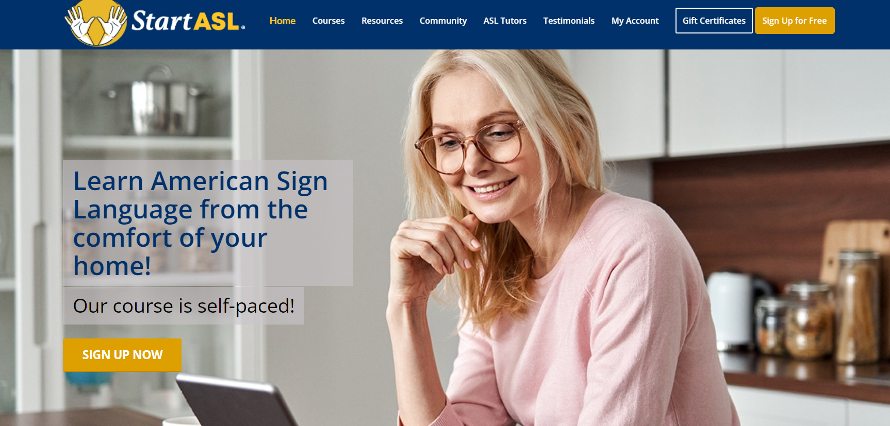
Related Works
startasl:
Start ASL offers us multiple options to choose from that suits you, you can choose the courses section in case you are a student who wants to learn sign language. You can also choose the School Options section in case you are a teacher, school, home school or organization.

Slide 13
Problem Definition
Deaf and dumb people have a lot of difficulties. Imagine that you live in a world
where no one knows your language and you have to navigate everyday life using
interpreters and special services to help you communicate with others. Imagine a world
where everyone is deaf, and you are the only one who hears it, and you are excluded
because of your “hearing” disability And you are classified as “another type.” This is
the reality of the deaf community
There are approximately 1.4 million deaf and hard of hearing people living in the
USA within the state of Michigan and more than 38 million deaf and hard of hearing
people all over the other America, where the deaf community is a vibrant but
unfortunately, incredibly marginalized community from Before the mainstream audio
community
Deaf people endure daily discrimination and oppression. Deaf people have faced
generations of systematic discrimination including forced sterilization in the twentieth
century. The relationship between the hearing community and the deaf community is
often strained due to the continuing lack of understanding of the deaf community.
Therefore, we wanted to make a site to teach sign language easily from home to help
spread sign language in the world and the ordinary person can learn sign language, not
just the deaf person, so that we are able to understand each other easily in the world.

Slide 14
Proposed System
A proposed system for an educational website for learning sign language can include the following components:
1. User registration and login: Users can create an account and login to access the sign language learning materials.
2. Learning modules: The website can include different modules for learning sign language, including beginner, intermediate, and advanced levels. Each module can include lessons, videos, quizzes, and interactive exercises.
3. Glossary: The website can provide a comprehensive glossary of sign language terms and phrases, with video demonstrations and examples.
4. Progress tracking: The website can track users' progress in each module and provide feedback on their performance. This can motivate users to continue learning and improve their sign language skills.
5. Community features: The website can include features for users to connect with each other, including discussion forums, chat rooms, and social media integration. This can create a sense of community and support among users.
6. Accessibility features: The website should be designed with accessibility in mind, including compatibility with assistive technologies, such as screen readers and keyboard navigation, and providing captioning and audio descriptions for videos.
7. Feedback mechanism: The website can provide a feedback mechanism for users to share their thoughts and suggestions for improving the website and its content.
Overall, an educational website for learning sign language should be user-friendly, interactive, and accessible, with engaging content and features that support users' learning and progress.

Slide 15
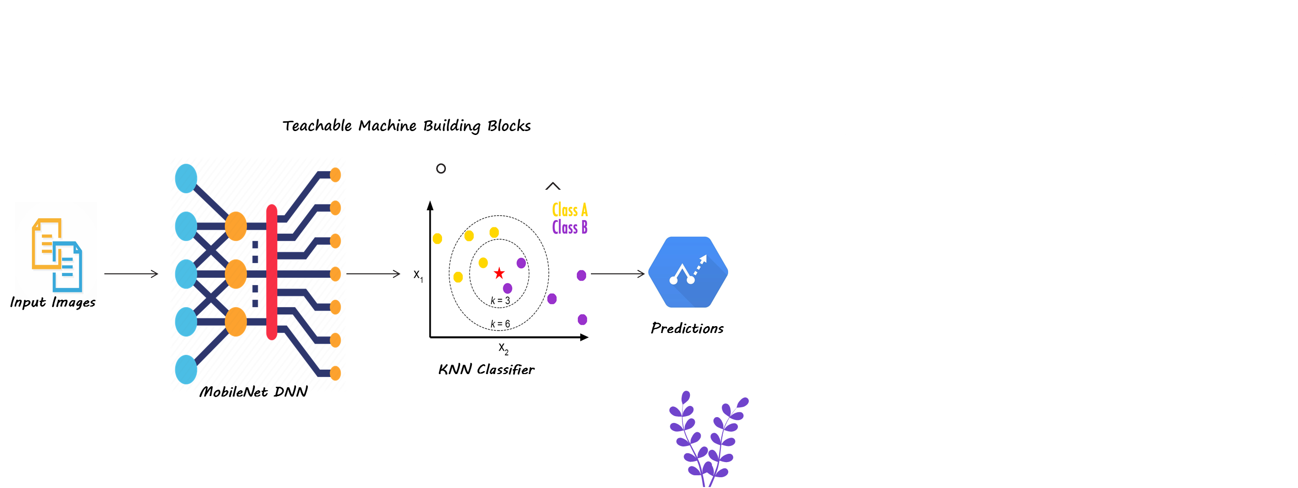
Methodologies and Techniques

Slide 16
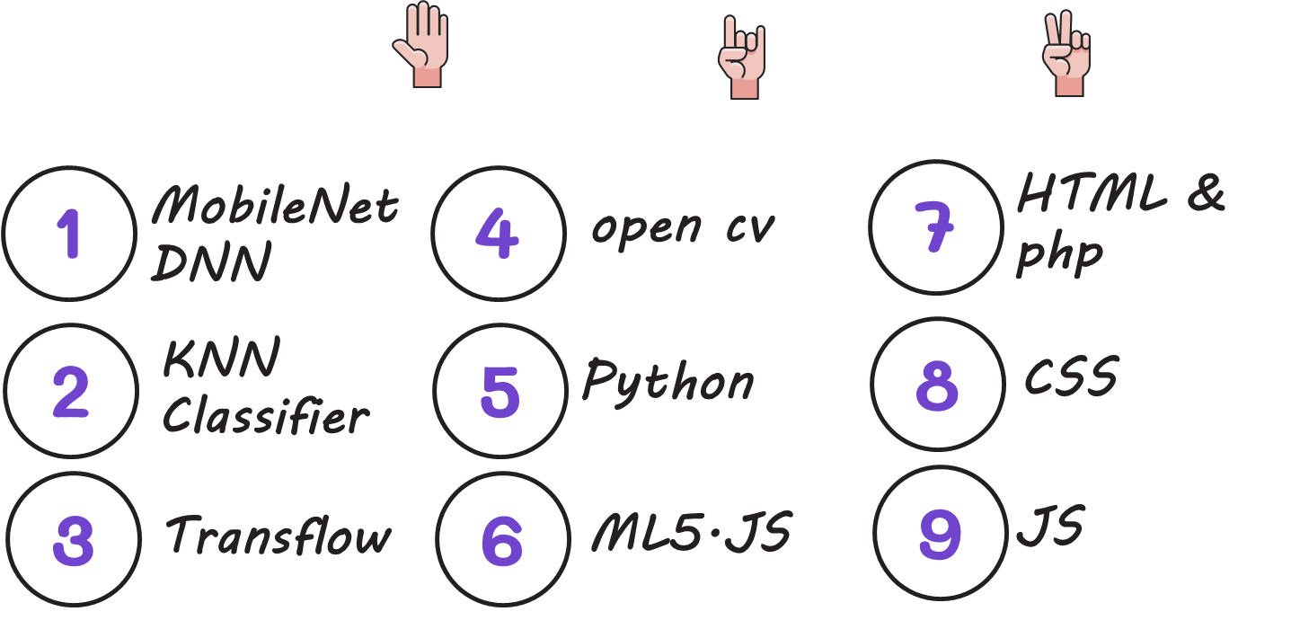
Methodologies and Techniques

Slide 17
System Requirements (S/W and H/W Tools)
Software Tools:
AI:
● Python
● TensorFlow
● Keras
● OpenCV
Web:
● HTML
● CSS
● JavaScript
Database:
● SQL
Front End:
● HTML – JavaScript – CSS
Back End:
● Python
Hardware Tools:
There is no hardware Tools

Slide 18
Results and Outcomes
Uses MobileNet and KNN classifier to classify the gestures. The user also has the privilege to save the model, upload a pre-trained model, and record gestures while speaking to other people. It also consists tutorial's page containing 100+ most commonly used phrases , alphabets , etc and a practice page to practice alphabets signs against a deep learning model.
The model and text to speech can be embedded into a video calling system. Thereby allowing the user to show the gestures and the receiver on the call will receive the message in the form of text or speech. While the receiver responds, the message will be relayed to the hearing/speech impaired user via text (subtitles).

Slide 19
System Validation
1. Usability testing: Conduct usability testing with actual users to evaluate the website's ease of use, navigation, and accessibility. The testing should involve a diverse group of users, including those with disabilities, to ensure that the website is inclusive and user-friendly for everyone.
2. Content evaluation: Evaluate the website's learning materials, including lessons, videos, quizzes, and interactive exercises, to ensure that they are accurate, up-to-date, and comprehensive. The content should be reviewed by sign language experts and educators to ensure its quality and relevance.
3. Performance testing: Conduct performance testing to evaluate the website's loading speed, responsiveness, and scalability. The testing should simulate high traffic and usage to ensure that the website can handle large volumes of users and data.
4. Security testing: Conduct security testing to evaluate the website's security features, including data encryption, user authentication, and protection against cyberattacks. The testing should identify any vulnerabilities and ensure that the website complies with data privacy and security regulations.
5. User feedback: Collect user feedback through surveys, feedback forms, and social media to evaluate the website's effectiveness and user satisfaction. The feedback should be analyzed and used to improve the website's content, features, and functionality.
Overall, system validation for an educational website for learning sign language should ensure that the website is usable, accessible, secure, and effective in supporting users' learning and progress. The testing and evaluation should be ongoing to ensure that the website remains up-to-date and responsive to users' needs and feedback.

Slide 20
Conclusion
The ISL program so far, has been very productive over a very short period. Within two-and-a-half years, more than 250 hearing people received training in ISL at the basic and/or advanced level. The system provides an interface that can easily communicate with deaf people by Sign Language Recognition. The system is not only can apply in family environment, but also can apply in public. For the Social use, these system is very helpful for deaf and dumb people

Slide 21
References
[1] https://ar.wikipedia.org/wiki/%D9%84%D8%BA%D8%A9_%D8%A5%D8%B4%D8%A7%D8%B1 %D8%A9
[2] https://www.deafwebsites.com/learning-sign-language.html
[3] http://www.lifeprint.com/asl101/lessons/goals_01.htm
[4] https://slcb.ca/en/12-good-reasons-to-learn-sign-language%E2%80%AF/
[5] https://blog.ai-media.tv/blog/7-reasons-sign-language-is-awesome
[6] https://air.imag.fr/index.php/Proj-2013-2014-Sign2Speech-SRS
[7] http://sandlersignlab.haifa.ac.il/html/html_eng/pdf/Sign_Language_Overview_ELL2.pdf
[8] https://www.irjet.net/archives/V6/i3/IRJET-V6I3639.pdf
[9] https://create.arduino.cc/projecthub/173799/a-glove-that-translate-sign-language-into-textand-speech-c91b13
[10] https://www.theatlantic.com/technology/archive/2017/11/why-sign-language-gloves-donthelp-deaf-people/545441/
[11] https://tallyfy.com/uml-diagram/
[12] https://www.visual-paradigm.com/guide/data-flow-diagram/what-isdata-flow-diagram/
[13] https://www.atlassian.com/agile
[14] https://www.atlassian.com/agile/project-management
[15] https://www.volusion.com/blog/search-algorithms/
[16] https://www.deafwebsites.com/learning-sign-language.html
[17] http://www.lifeprint.com/asl101/lessons/goals_01.htm
[18] https://slcb.ca/en/12-good-reasons-to-learn-sign-language%E2%80%AF/
[19] https://blog.ai-media.tv/blog/7-reasons-sign-language-is-awesome
[20] https://air.imag.fr/index.php/Proj-2013-2014-Sign2Speech-SRS

Slide 22


